Slide 1
Description of what’s for sale:
An ultra-high vacuum (UHV) system designed to simulate the space environment of a geosynchronous satellite replicates the conditions encountered by such a satellite in orbit. This includes considerations for vacuum, temperature, radiation, and other factors. Here's a general description of what the system includes:
Vacuum Chamber: The core of the system would be a large vacuum chamber capable of reaching pressures on the order of 10^(-9) Torr or lower. This simulates the extremely low pressure of outer space.
Pumping System: A combination of pumps such as ion pumps, turbomolecular pumps, and cryopumps would be used to achieve and maintain the ultra-high vacuum conditions.
Temperature Control: The system would include heating and cooling elements to simulate the temperature extremes encountered by a geosynchronous satellite. This could involve resistive heaters and cryogenic cooling systems.
Radiation Simulation: Depending on the fidelity of the simulation, it might also include sources of radiation to replicate the effects of cosmic rays and solar radiation on the satellite. This could be achieved using gamma or X-ray sources.
Solar Simulation: If simulating the effect of sunlight is necessary, high-intensity lamps or other light sources may be used to replicate the spectrum of sunlight in space.
Motion Simulation: To simulate the geosynchronous orbit, some systems may include platforms capable of rotating or otherwise moving the test object to replicate the motion and orientation of the satellite in space.
Material Outgassing Control: Since materials can behave differently in a vacuum, special attention would be paid to the choice of materials within the chamber to minimize outgassing, a phenomenon where trapped gases are released from materials under vacuum.
Monitoring and Control System: A sophisticated set of sensors and control systems would be needed to carefully monitor and adjust the conditions within the chamber, ensuring that they closely replicate the space environment.
Safety Measures: Due to the extreme conditions within the chamber, various safety measures would be in place to protect operators and equipment. This could include interlocks, emergency shutdown systems, and shielding for radiation sources.
Integration with Other Testing Systems: If the UHV system is part of a broader testing program, it might also include features to enable integration with other testing or measurement systems, such as vibration testing, electromagnetic interference testing, etc.
A system like this would be highly complex and would likely require customization to match the specific needs of the satellite being simulated. It would be used primarily in research and development, pre-launch testing, and validation of satellite systems and components. The cost of such a system would be substantial and would depend on the specific requirements of the simulation.

Slide 2
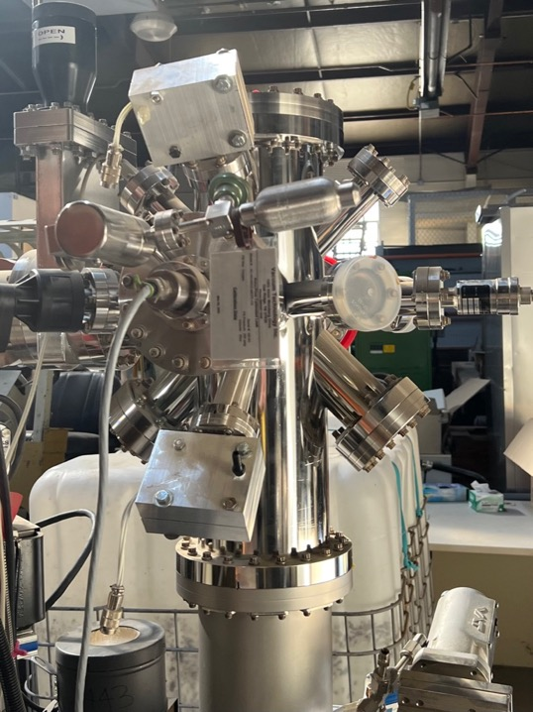
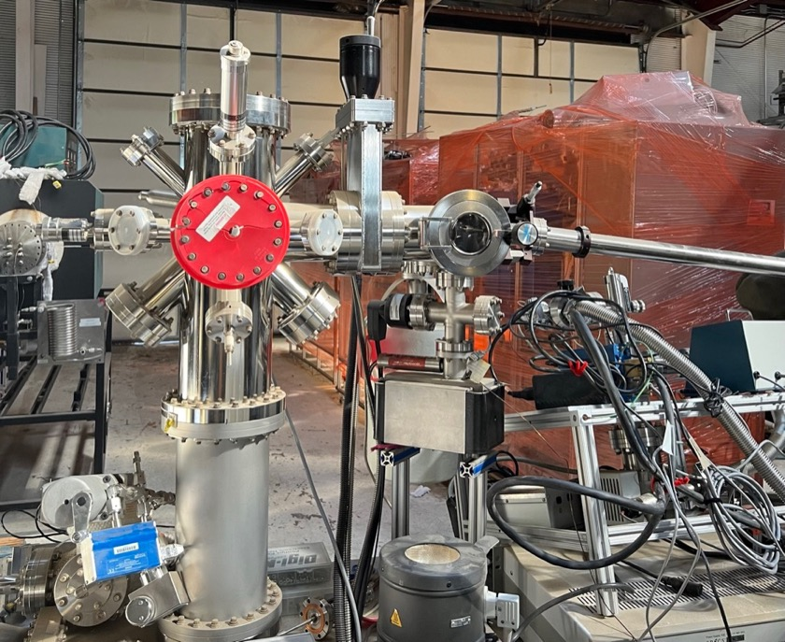
Ultra-high vacuum chamber with all sensors / gauges to simulate the space environment of geosynchronos satellites: $100,000 - $200,000
This is a specialized complex system custom designed to simulate the space environment of geosynchronos satellites and could easily cost $100,000 to $200,000 or more as is.

Slide 3
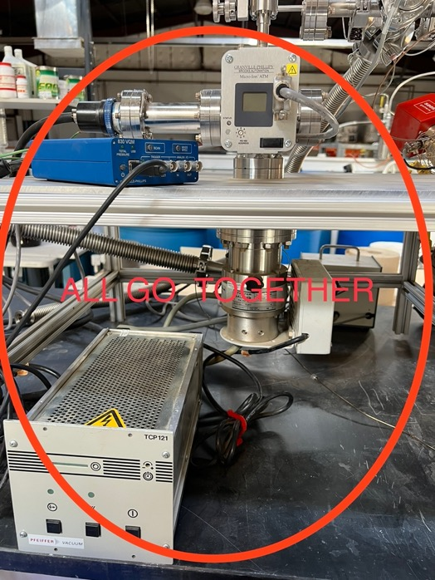
Pfeiffer molecular diffusion vacuum pump: estimate $10,000
Specs out at mid-range model, $5,000 - $15,000
Pfeiffer is a well-known manufacturer of vacuum equipment, including molecular diffusion pumps. The cost of a Pfeiffer molecular diffusion pump can vary widely based on factors such as the pump's size, capacity, specific model, and any additional features or accessories.
Smaller Models: Starting from $2,000 to $5,000 for smaller capacity pumps, often used in laboratory settings.
Mid-Range Models: Between $5,000 to $15,000 for medium-sized pumps with more robust capacity, suitable for industrial or research applications.
Larger, Industrial Models: Could range from $15,000 to $40,000 or more for high-capacity models designed for demanding industrial applications.
These prices are rough estimates and may vary based on factors such as regional pricing differences, specific requirements, vendor markup, and any included warranties or service agreements.

Slide 4
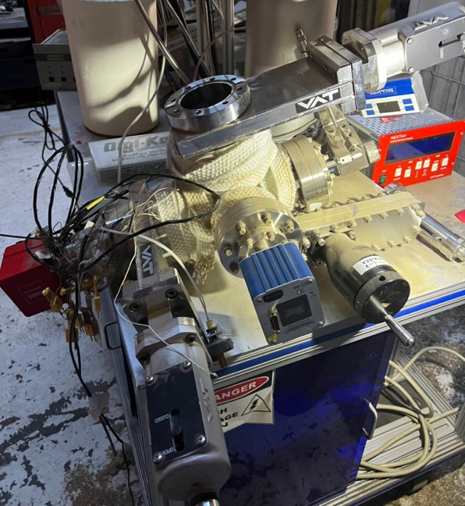
Oxygen ion gun, mid-range - high-end model: $10,000 - $60,000
The cost of an oxygen ion gun can vary widely depending on its specifications, features, and the manufacturer.
Entry-Level Models: Simpler and more basic oxygen ion guns designed for general-purpose applications might start in the range of $5,000 to $10,000.
Mid-Range Models: More advanced models with additional features, precision control, or specialized capabilities might fall in the range of $10,000 to $30,000.
High-End Models: Oxygen ion guns designed for specialized research, high precision, or industrial applications might cost $30,000 to $60,000 or even more, depending on customization and specific requirements.
It's essential to note that these prices are just general estimates, and the actual cost could differ based on various factors such as the manufacturer, the region, the specific needs of the application, and any additional accessories or customizations required.
Contact the manufacturer if you want a better estimate.
https://www.vatvalve.com/?_locale=en&region=US

Slide 5
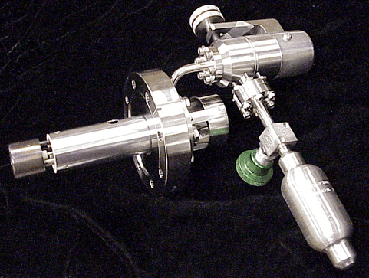
Oxygen ion gun: $30,000 - $60,000
Space simulation VAT:
https://www.vatvalve.com/applications/research/space-simulation-2
An oxygen ion gun is a specialized piece of equipment used in an ultra-high vacuum (UHV) system for various purposes. Here's how it typically functions:
Creation of Oxygen Ions: The gun generates oxygen ions by ionizing oxygen gas. This is often accomplished using an electron beam to knock electrons off oxygen atoms, resulting in positively charged oxygen ions.
Acceleration and Focusing: The oxygen ions are then accelerated and focused into a beam using electric and magnetic fields.
Surface Interaction: The accelerated ion beam can be directed at a sample surface within the vacuum chamber. Depending on the energy and focus of the beam, different effects can be achieved.
Applications of Oxygen Ion Gun in UHV System:
Surface Cleaning: Oxygen ions can be used to clean surfaces by sputtering away contaminants. This is particularly useful in preparing surfaces for scientific analysis or for thin film deposition in manufacturing.
Surface Modification: The energetic oxygen ions can interact with the surface of a material to modify its structure, composition, or other properties. This can be used to create specific surface characteristics, such as increased roughness or altered chemical reactivity.
Oxidation Studies: By using an oxygen ion gun, scientists can study how materials interact with oxygen under controlled conditions. This can be crucial in understanding the oxidation behavior of metals, semiconductors, and other materials.
Depth Profiling: Oxygen ion beams can be used in conjunction with other techniques like X-ray photoelectron spectroscopy (XPS) for depth profiling of materials. By selectively sputtering away layers of the material with the ion gun, researchers can analyze the composition at different depths.
Ion Beam Etching: In semiconductor manufacturing and other applications, a focused ion beam can be used to etch precise patterns on a substrate.
Catalysis Research: Oxygen ion guns can also be employed in catalysis research, helping to understand and develop catalysts that facilitate specific chemical reactions.
The integration of an oxygen ion gun into a UHV system requires careful consideration of the vacuum requirements, as the introduction of oxygen gas can potentially interfere with the ultra-high vacuum conditions. This often necessitates precise control and isolation mechanisms to maintain the required vacuum levels within other parts of the system.
The use of an oxygen ion gun in a UHV environment allows for highly controlled interactions between the oxygen ions and the sample surface, free from interference by other gases or contaminants. This enables precise and reproducible experiments or manufacturing processes.
https://www.vatvalve.com/?_locale=en&region=US

Slide 6

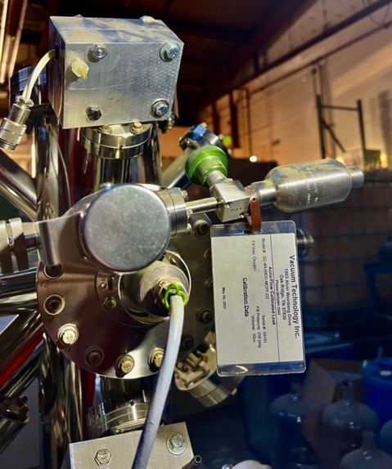
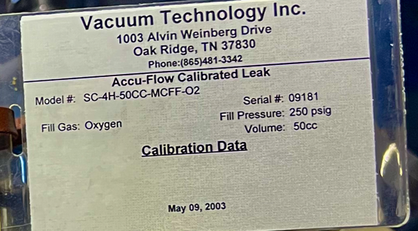
Oxygen ion gun
deuterium lamp housed inside aluminum blocks w/ inlet/outlet nozzles for air cooling
Oxygen ion gun used to simulate atomic oxygen in low-earth orbit.

Slide 7
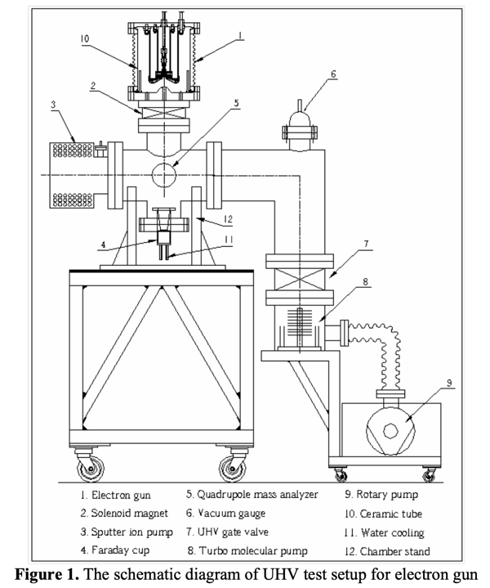
Some UHV Guidelines
https://www.vacuumscienceworld.com/blog/working-under-hv-uhv-conditions?hs_amp=true

Slide 8
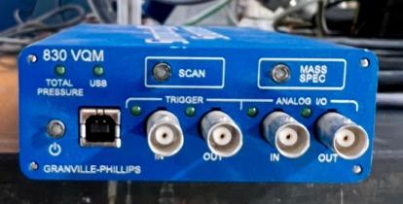
This is a molecular diffusion pump. It may have been used with the chamber and replaced with the ion diffusion pump currently on the UHV chamber. Needs a roughing pump. It needs a computer and software
Pfeiffer vacuum pump

Slide 9
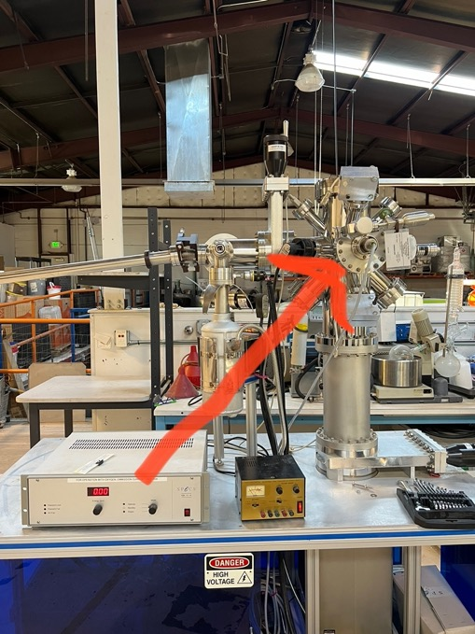
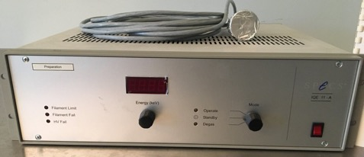
https://www.hamamatsu.com/us/en/product/light-and-radiation-sources/lamp.html
Power supply for deuterium lamps housed in aluminum blocks with inlet-outlet ports for I assume air cooling. need cables to connect.
Powers
$985 - $1995 used to power ion source similar to:
https://www.specs-group.com/nc/specs/products/detail/iqe-1135/
SPECS IQE 11-A ion source power supply

Slide 10
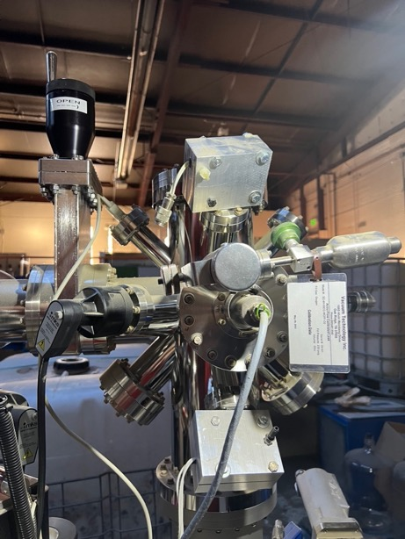
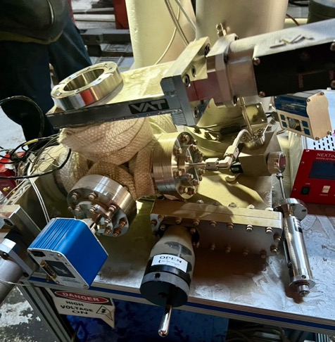
Deuterium lamps housed in aluminum blocks with nozzles for air cooling. Used to take measurements
attaches here.

Slide 11


Slide 12
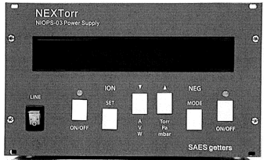


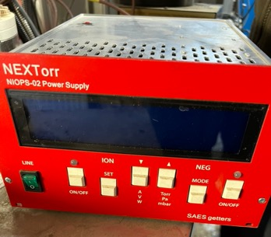
https://www.vatvalve.com/?_locale=en&region=US
https://www.saesgetters.com/products-functions/products/neg-pumps%26vacuum-solutions
https://www.saesgetters.com/sites/default/files/NEXTorr products Datasheets.pdf
https://www.saesgetters.com/products/nextorr-pumps
NEXTorr NIOPS-02 Power Supply operates the SAES getters ion pump
downloaded instructional manual

Slide 13
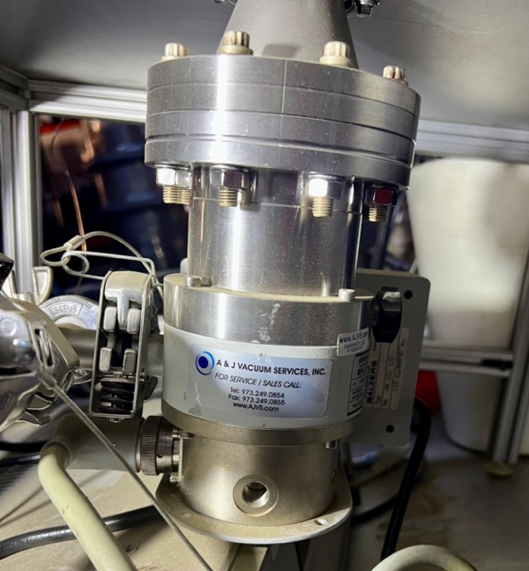
UNDERNEATH – ion pump vacuum attachment
A & J Vacuum Services
https://www.ajvs.com/new/index.php

Slide 14
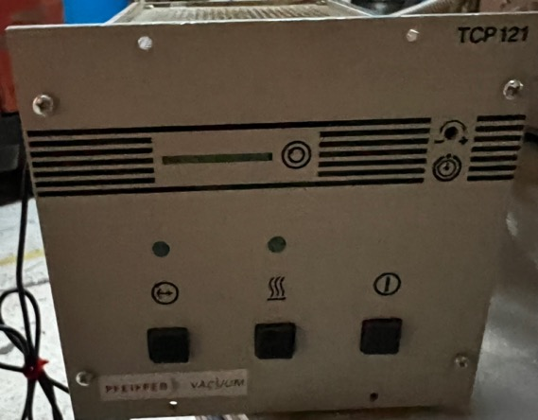
PFEIFFER Vacuum TCP121 turbo pump controller power supply PMCO1497B
A & J Vacuum Services link to product
https://www.ajvs.com/new/product_info.php?products_id=340
Have instruction manual downloaded
https://www.radwell.com/Shop?source=GoogleShopping&IgnoreRedirect=true&ItemSingleId=25548770&utm_source=google&utm_medium=cpc&adpos=&scid=scplp25548770&sc_intid=25548770&gclid=Cj0KCQiA6rCgBhDVARIsAK1kGPKNU1Ju8HU-qwm7TX0qzTappCwEiwDgeTiI3x9MAXPh1TER3NJT9sIaApCpEALw_wcB

Slide 15
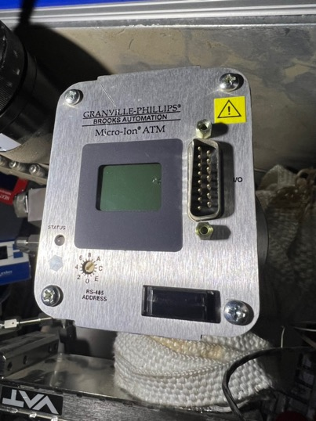


Slide 16
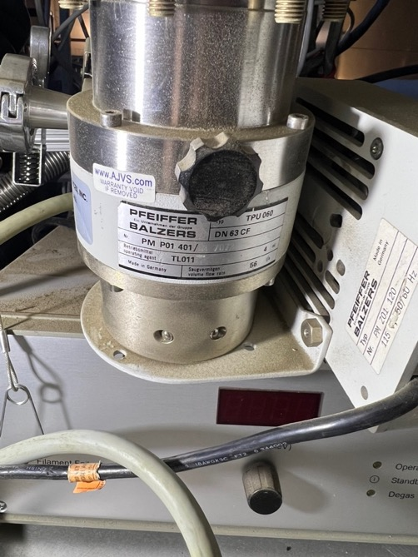
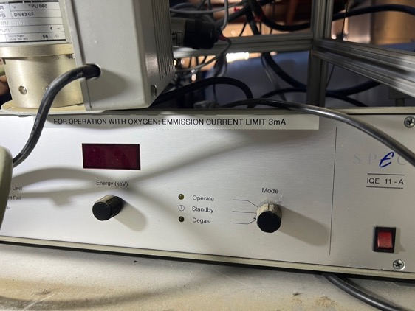

Slide 17
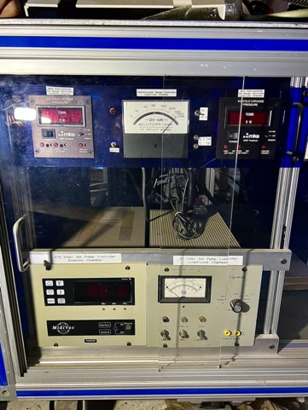
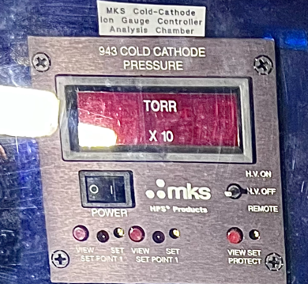
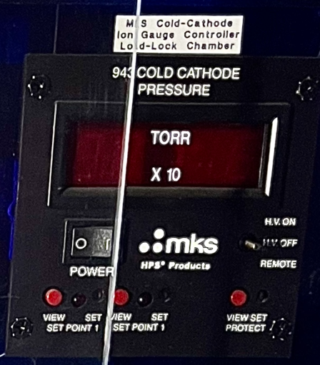
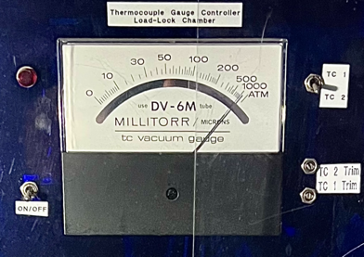

Slide 18
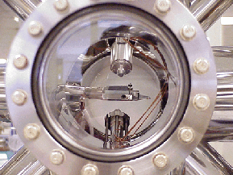
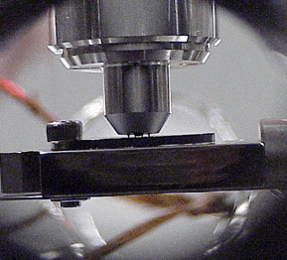
View-port of vacuum chamber. Sample is in center. A UHV compatible four-point probe is at the top. An oxygen sputter gun is at the bottom.
Ultrahigh vacuum compatible four-point probe in contact with a sample.

